Slide 1
Template Design Pattern
Brett Recker
Radwan Albadawi

Slide 2
Story
In software engineering the template method pattern is a behavioral design pattern that defines the program skeleton.
Used to create a GROUP of subclasses that have EXCUTED SIMLUAR group of methods
Serious methods calls that every subclass object will call

Slide 3
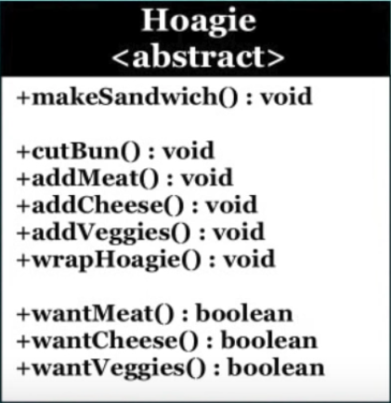
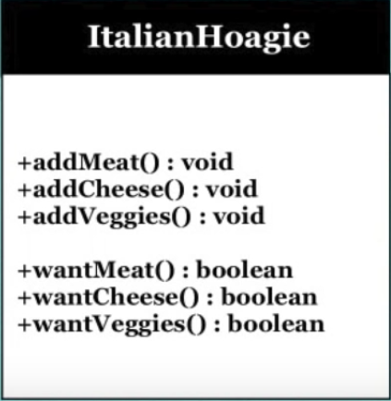
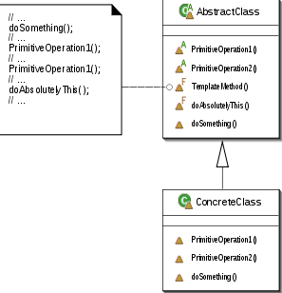
UML Design

Slide 4
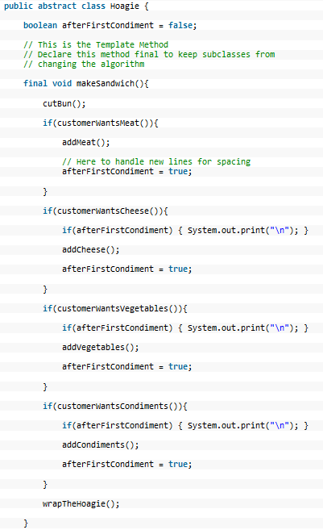
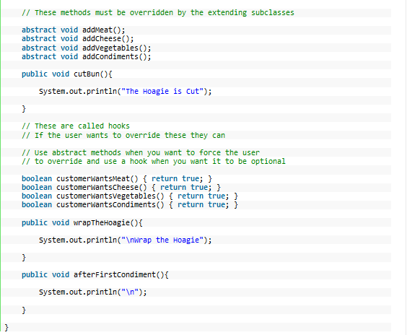
Code

Slide 5
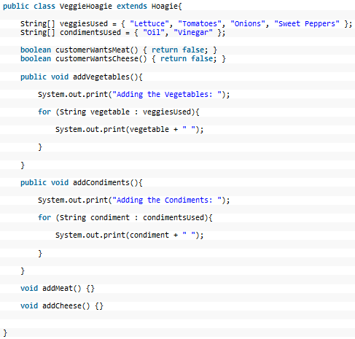
Code

Slide 6
Quiz
The subclass objects can’t override some of the template method calls?
We don’t need template method if the subclasses will not be calling similar calls?
The template method cannot be define in the abstract classes?
Notes:
Abstraction and Implementation

Slide 7
Sources
Design Pattern

